Slide 1
early discovery of anxiety/depression in teenagers using digital tools

Slide 2
Introduction
The Early Discovery of Anxiety and Depression in Teenagers app uses digital tools to identify and monitor mental health challenges among adolescents. By tracking Reddit activity, app usage patterns, and user reflections, combined with AI-powered sentiment analysis and heuristic scoring, the app provides insights into emotional well-being. Its goal is to promote early intervention and support by highlighting potential signs of anxiety or depression in a user-friendly way.

Slide 3
Mvp functionalities
User authentication: users can easily create and use an account via credentials; all in a secure environment for protecting the user's privacy
Reddit Integration: by exposing an OAuth Login, the app will unveil(fetch) user activity on the app(posts, comments) later being exposed to the Sentiment Analysis component
Sentiment analysis: the posts will be analyzed using an AI model by the app; predicting a sentiment for each prompt
Heuristic scoring: heuristic based system that aggregates sentiment predictions for an accurate individual's mental state assessment
Post analysis: based on the previous results, the user's portrait will be outlined and filtered to determine his/her state of mind
Journal Entry: daily journal entries to reflect emotions, sentiments
App Usage: ...

Slide 4
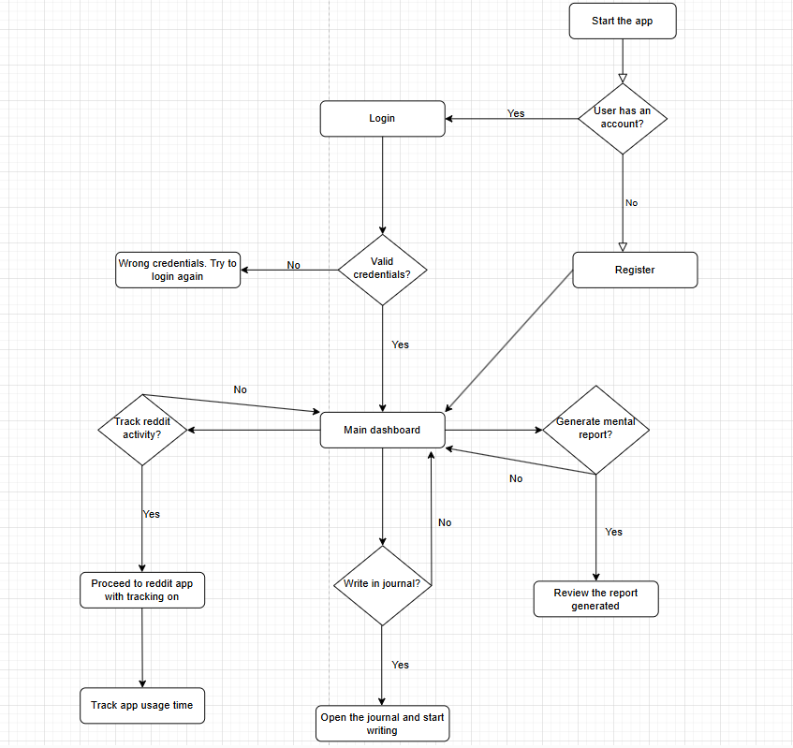

Slide 5
Innovative product

Slide 6
Numerical results
The app analyzed 80 user activities, including posts, comments, and reactions, with 60% categorized as normal, 30% as anxiety, and 10% as depression, resulting in a heuristic score of -12 (indicating anxiety) for a sample user. Users spent an average of 12 minutes per session, with the majority of interactions focused on technology and personal development subreddits.

Slide 7
Tech + local deployment + a bit ai + code quality,rest,separation etc.
Tech stack:
-Backend: Flask (perfect for managing complex data flow), SQLite3, OAuth, TextBlob
-Frontend: Flutter + Dart for a seamless mobile integration
-Additional: Git for version control and Postman for API testing
Abstract tech features: The app utilizes a modular frontend, RESTful backend, secure OAuth 2.0 for Reddit integration, AI-driven sentiment analysis, heuristic scoring, and adaptive design to provide users with seamless interaction, emotional insights, and cross-platform compatibility while prioritizing data security and privacy.

Slide 8
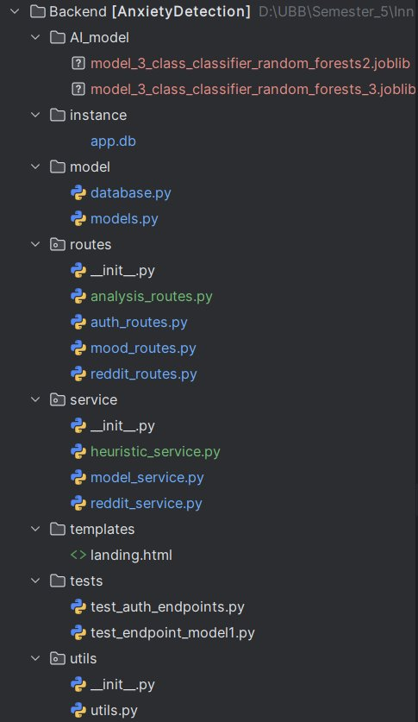

Slide 9
Market Analysis
The global mental health apps market has been experiencing significant growth.
Specifically focusing on youth mental health, the market is projected to reach USD 26 billion by 2027, highlighting a substantial opportunity for growth in this segment.
Growing awareness of teenage mental health drives demand for tailored solutions.
We estimate that the market will evolve with increased adoption of digital tools, driven by a growing reliance on technology for mental health support.

Slide 10
Needs addressed
The product addresses the growing need for greater self-awareness, helping users understand their mental well-being, recognize early signs of anxiety or depression, and know when seeking professional help could be beneficial.
Most competitors focus on mental health improvement through mindfulness, mood tracking, and therapy techniques, often offering active tools like meditation, CBT, or journaling. However, they generally don't include passive tracking of social media usage or analyze the correlation between online behavior and mental health (Headspace, Woebot, Moodpath, Sanvello, etc).
Our app apart from the competition is its ability to passively monitor social media usage and analyze the correlation between online behavior and anxiety or depression, providing a deeper, data-driven understanding of mental health patterns.

Slide 11
User Persona
Teenagers and young adults using social media excessively, seeking to understand how it affects their mental well-being and find support during moments of anxiety or depression.
Psychologists seeking deeper insights into their patients' social media usage and its impact on their mental health progress, helping them tailor treatment plans more effectively.

Slide 12
Value Proposition
The app uniquely combines social media monitoring with mental health tracking, offering a new perspective not available in other apps.
For psychologists, the app provides data-driven insights into patients' social media behavior and its impact on their mental health, optimizing treatment plans.
For the usual customer it offers personalized awareness by analyzing social media usage, helping users understand its influence on their well-being.

Slide 13
Business Model
B2C: Offer a free version with limited access, supported by ads, and a subscription plan for full features, including social media analysis and personalized mental health insights, with a free trial.
B2B: Provide a subscription-based plan for psychologists with advanced features, including detailed patient reports and data insights, along with a free trial for professionals.

